Slide 1
Dengue Case Count Prediction
By :
Ronak Sankaranarayanan
Sitanshu Rupani
Siddhi Patil

Slide 2
INTRODUCTION
1

Slide 3
Dengue Fever
Mosquito borne viral infection.
Tropical and Subtropical region
Common in 120 countries.
390 million cases every year.
40,000 death every year.
Higher rainfall, higher case count

Slide 4
San Juan, Puerto Rico
City closer to equator and has tropical climate.
Has cases of Dengue year around.
More than 1000 cases each year.
Iquitos, Peru
South America, Amazon forest.
More than 1000 cases each year.

Slide 5
Dataset
From Competition hosted by DRIVENDATA
Weekly data from 1990 to 2010
Independent variables : Average weather measurements. Example : Humidity, Temperature, precipitation, Vegetation index etc.
Target variable : Weekly confirmed cases

Slide 6
DATA EXPLORATION
2

Slide 7
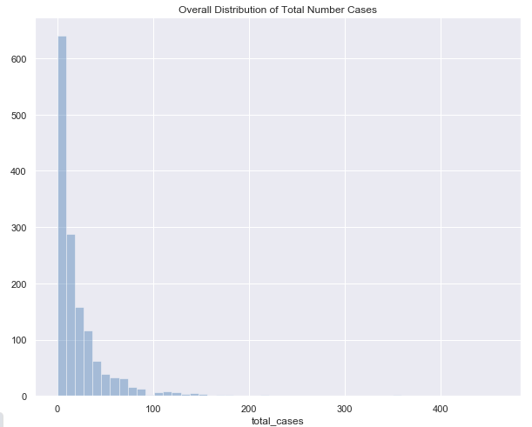
Overall Distribution of Total Dengue Cases

Slide 8
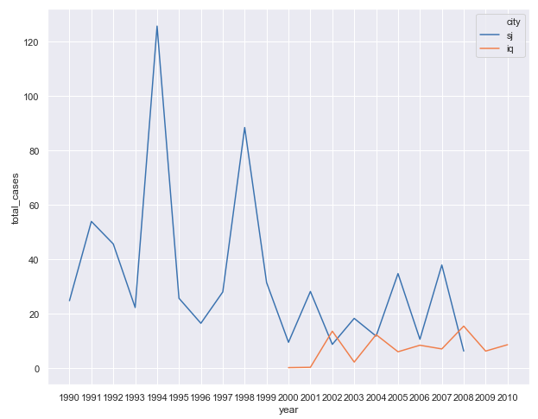
Average Total Cases reported over Years
San Juan: Iquitos:

Slide 9
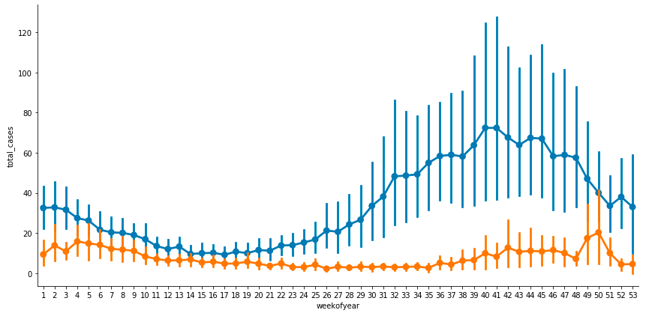
Total Cases over every week
San Juan: Iquitos:

Slide 10
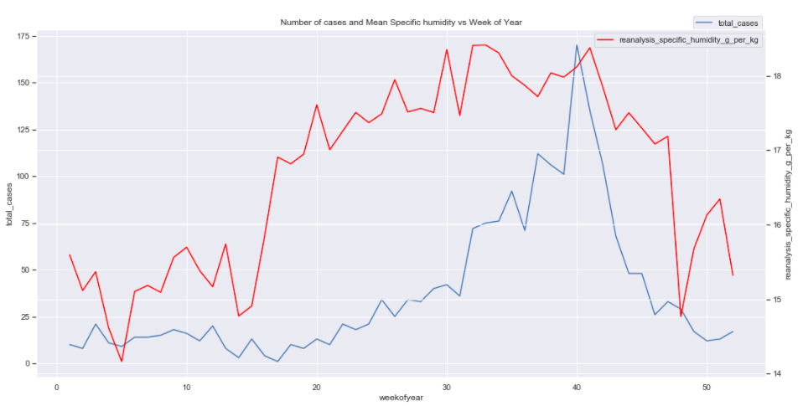
Trend between Number of Cases and Humidity (Year: 2007, City: San Juan)
Total Cases: Humidity:

Slide 11
MODEL & RESULTS
3

Slide 12
Lasso Regression

Slide 13
Results
Training Set fed into model had 74 variables
Lasso Regression chose 33 as significant
RMSE: 25.42
Most related with high number of dengue cases: Humidity and Air Temperature

Slide 14
THANKS!
Any questions?

